Slide 1
Immigration and the population of Canada: The role of policy
Roderic Beaujot
Emeritus Professor of Sociology
Western University
Based on Beaujot and Raza, 2013. Population and Immigration Policy, Pp. 129-162 in Kasoff and James, Editors, Canadian Studies in the New Millennium, University of Toronto Press
For presentation to Colloquium of the Centre for Research on Migration and Ethnic Relations
26 September 2013.

Slide 2
Purpose
Role of immigration and immigration policy in the population history of Canada
Implications for Canada and for immigrants
Policy discussion:
  level and composition of immigration
  Integration of immigrants

Slide 3
Outline
1. Context:
  Migration in population history
  Conceptualizing migration
2. Phases of immigration in historical and policy context:
    1608-1760: New France
    1760-1860: British Colony
    1860-1896: net out migration
    1897-1913: first wave of post-Confederation migration
    1914-1945: interlude
    1946-1961: post-war white immigration
    1962-1988: diversification of origins
    1989-present: sustained high levels
3. Implications
  Demographic: growth, distribution, age structure
  Socio-cultural and socio-economic

Slide 4
World Context:
Migration in Population history
Zelinski, 1971: mobility transition
  1850-1950: North to South
  1950-2050: South to North
Two periods of globalization
  1900-1914
  Post-war

Slide 5
Context: conceptualizing migration
Two questions: whether and where
Whether to move:
Natural tendency not to move
Social integration and life course factors
Where to move: streams of origins and destinations
-Push-pull factors and barriers
-Political Economy: mobile populations and demand for labour in the largest cities (Massey et al., 1994)
-Transnational perspectives: networks and institutions (Simmons, 2010)

Slide 6
Phases: Pre-contact population
Estimate of 300,000 (Charbonneau, 1984)
It took almost two centuries, 1608-1790 for the European population to reach this figure.
Three centuries of aboriginal depopulation (1600-1900).

Slide 7
Phases: New France, 1608-1760
Charbonneau et al., 2000: During the period of New France, it is estimated that at least 25,000 immigrants had spent at least one winter in the new colony, with 14,000 settling permanently, and 10,000 marrying and having descendants in the colony.
1760 Population (white, European):
Canada: New France, 70,000
USA: British Colonies, 1,267,800
US/Canada, 1760: 18.1 times

Slide 8
Phases: British Colony, 1760-1860
English in Quebec
1765: 500
1791: 10,000
United Empire Loyalists: 40,000 (mostly in 1784)
Britain: After war of 1812 and return to peace in Europe and North America: arrivals from Britain increase, … further increases with epidemics in 1830s and potato famine in 1840s. Private and public authorities support immigration from British Isles.
Emigration from Canada to New England: gains strength in 1830s for both recent arrivals and population of French descent.

Slide 9
Phases: British Colony, 1760-1860
1821-1861: total net immigration of 487,000, that is 20% of population increase over the period.
US and Canada
1760* 1790* 1790** 1860
US 2,267.8 3,172.0 3,929.3 31,443.0
Canada 70.0 260.0 260.0 3,230.0
US/Canada 18.1 12.2 15.1 9.7
Note: * white only, excludes aboriginal and U.S. black
** excludes aboriginal

Slide 10
Phases: Net out migration, 1860-1896
1861-1901
immigration: 892,000
emigration: 1,891,000
net loss: 999,000
Immigration legislation
Free Grants and Homestead Act, 1868
Chinese Immigration Act, 1885
US and Canada
1860 1900
US 31,443.0 75,994.0
Canada 3,230.0 5,301.0
US/Canada 9.7 14.3

Slide 11
Phases: First wave of post-Confederation immigration, 1897-1913
Immigrants
1896: 17,000
1913: 400,000
Economic conditions, policy support
Restrictions:
1907 and 1908: limit immigration from Japan and India
Immigration Acts of 1906 and 1910
US and Canada
1760 1900 1920
US 2,267.8 75,994.0 106,711.0
Canada 70.0 5,301.0 8,556.0
US/Canada 18.1 14.3 12.5

Slide 12
Phases: Interlude, 1914-1945
Annual arrivals, 1933-44: under 20,000
Policy
Immigration Act, 1919 amendments
Empire Settlement Act, 1922
Railway Agreement, 1925
US and Canada
1920 1950
US 106,711.0 150,697.0
Canada 8,556.0 13,712.0
US/Canada 12.5 11.0

Slide 13
Phases: 1946-1961, post-war white
Charles, Keyfitz and Rosenberg, 1946: projections assume zero net immigration to 1971
King’s Statement to Parliament, 1947
Immigration Act 1953
Arrangement for Asian Commonwealth countries, 1951-62: 300 per year from India, Pakistan and Sri Lanka
1951-1961:
Net migration as percent of population growth: 21%
Annual immigrants per 100 population: 0.95
1946-61: 2.4% of origins other than European, Australia and US

Slide 14
Phases: 1962-1988, diversification of origins
1962: lifting of national origin restrictions to immigration
1966: White Paper: positive for economic growth
1967: points system
1974: Green Paper: more guarded
1976: Immigration Act: target level, refugees as an immigrant class
1941-51 1951-61 1961-71 1971-81 1981-1
Net migration as % of growth 7% 21% 14% 42% 42%
Annual arrivals per 100 pop .43 .95 .71 .62 .52
Net migration per 100 births 5 24 18 33 36
1946-61 2001-06
Percent of from other than Europe, US and Australia 2.4% 80.1%

Slide 15
Phases: 1989-present, sustained high levels
1988: Canada-United States Trade Agreement
1992: North American Free Trade Agreement
Recession of early 90s: no reduction of immigration
Levels above 200,000: 21 of the 23 years 1990-2012
After 1985: independent class is dominant
Temporary residents: foreign workers, foreign students, humanitarian and refugee claimants
1981-91 1991-01 2001-11
Net migration as % of growth 42% 54% 67%
Annual arrivals per 100 pop .52 .76 .75
Net migration per 100 births 36 45 56

Slide 16
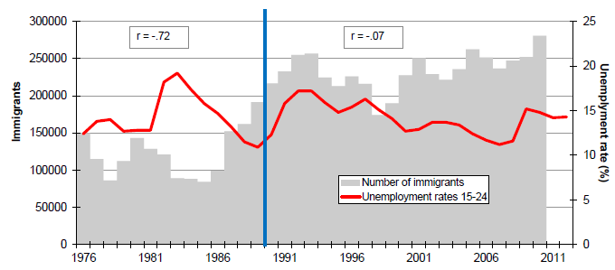
Immigration levels and youth unemployment, 1976-2011 (source: Bélanger, 2013)

Slide 17
Relative size of US and Canada
US/Canada
1760 18.1 (excludes aboriginal and U.S. black)
1790 15.1 (excludes aboriginal)
1860 9.7
1900 14.3
1920 12.5
1950 11.0
1960 10.1
1970 9.5
1980 9.2
1990 9.0
2000 9.3
2010 9.4

Slide 18
Figure 1. Immigration, emigration and temporary entries, 1985-2008

Slide 19
Immigration, emigration and temporary
2010 2012
Immigrants 281,000 258,000
Emigrants 50,000 51,000
Temporary entries 299,000 340,000
Non-permanent residents (stock)
1971: 85,000
1981: 130,000
1991: 395,000
2001: 323,000
2011: 627,000
2013: 704,000

Slide 20
Temporary resident entries
2010 2012
Foreign workers 179,000 214,000
Foreign students 95,000 105,000
Humanitarian 25,000 21,000
Total 299,000 340,000
Foreign workers, 2012
With international arrangements 13.6%
Workers – Canadian interests 47.8%
Workers with LMO 37.7%
Workers without LMO* 0.1%
*LMO: Labour Market Opinion

Slide 21
Figure 2. Class of arrival, 1978-2008

Slide 22
Economic immigrants, principal applicants
2010 2012
Skilled workers 48,800 38,600
Canadian experience class 2,500 5,900
Entrepreneurs 300 100
Self-employed 200 100
Investors 3,200 2,600
Prov/terr nominees 13,900 17,200
Live-in caregivers 7,600 3,700
Total 76,600 68,300

Slide 23
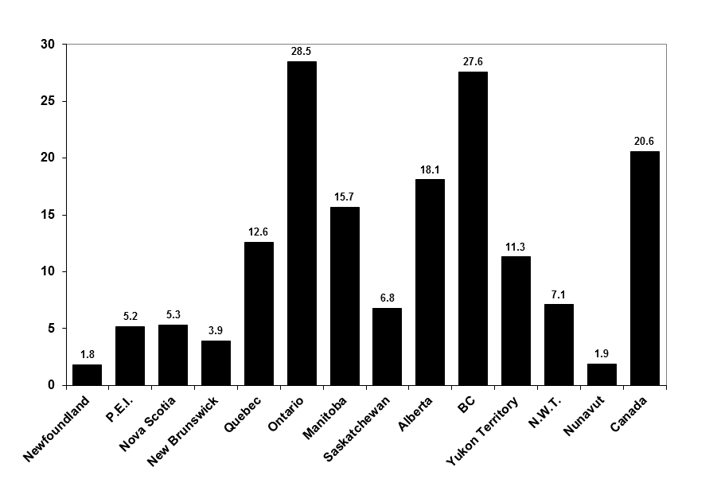
Figure 4. Percent foreign born, Canada and provinces, 2011

Slide 24
Demographic impact of immigration, 2006
median Percent Median age
age 65+ of labour force
Can born 36.9 11.4 43.7
Foreign born 45.8 18.8 47.6
Cohort
1970-74 56.6 20.0 53.3
1975-79 52.8 15.9 49.6
1980-84 49.0 16.3 45.9
1985-89 44.4 10.0 42.3
1990-94 41.5 10.2 39.4
1995-99 36.2 5.7 36.9
2000-06 31.1 3.3 34.2

Slide 25
Population size and age distribution under various immigration assumptions, 2036 and 2061 (source: Kerr and Beaujot, 2013)

Slide 26
Socio-cultural impact of immigration
Percent foreign born
1921 22%
1931 22
1941 18
1951 15
1961 16
1971 15
1981 16
1991 16
2001 18
2011 21

Slide 27
Table 3. Births and net migration, Australia, Canada, New Zealand and United States, 1950-2010

Slide 28
Table 4. Percent foreign born, 1960-2010, by continent and specific countries

Slide 29
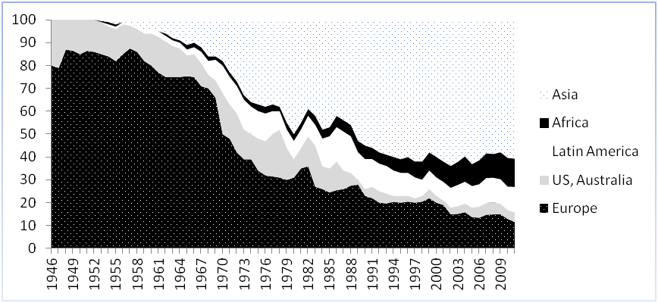
Place of birth of immigrants, 1946-2011

Slide 30
Socio-cultural impact of immigration
Ethnic origins, 1961 Census:
European 96.8%
Aboriginal 1.2%
Other 2.0%
Chinese 0.3%
Japanese 0.2%
Other Asian 0.2%
Black 0.2%
Other and not stated 1.2%
Aboriginal
1981: 2.0% Aboriginal ancestry (includes multiples)
2001: 3.3%
2011: 4.3% Aboriginal identity
Visible minority population
1981 4.7%
1991 9.4%
2001 13.4%
19.1%

Slide 31
Socio-cultural impact of immigration
1981 2011
Christian 90.0% 67.3%
Other 2.4 8.8
No religion 7.4 23.9
Muslim 0.4% 3.2%
Hindu 0.3 1.5
Sikh 0.3 1.4
Buddist 0.2 1.1
Jewish 1.2 1.0

Slide 32
Socio-cultural impact of immigration: languages
Mother tongue, 2011 (single responses only)
English 58.1%
French 21.7%
Other 20.1%
Home language, 2011 (single responses only)
English 67.1
French 21.4
Other 11.5
First official language spoken, 2011
English 74.5%
French 22.7%
English and French 1.1% (17.5% bilingual in official languages)
Neither 1.8%

Slide 33
Socio-economic impact of immigration, ages 25-64, 2006
Cert, degree or diploma
percent percent
in LF post-sec.
Can born 81.0 58.9
Foreign born 77.8 64.3
Cohort
1970-74 77.0 61.7
1975-79 81.4 62.5
1980-84 82.5 58.9
1985-89 81.7 58.9
1990-94 79.5 59.5
1995-99 78.5 67.6
2000-06 73.3 74.5

Slide 34
Average total income, 2005, ages 45-54
Men Women
Can born 1.00 1.00
Foreign born
Cohort
1970-74 1.02 .99
1975-79 .92 1.01
1980-84 .87 .93
1985-89 .84 .86
1990-94 .72 .74
1995-99 .66 .65
2000-06 .49 .46

Slide 35
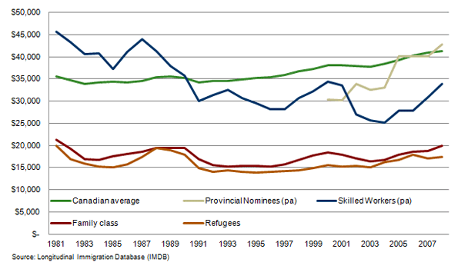
Average entry employment earnings by immigration category and tax year (2008 dollars) (source: Kustec, 2012: 17)

Slide 36
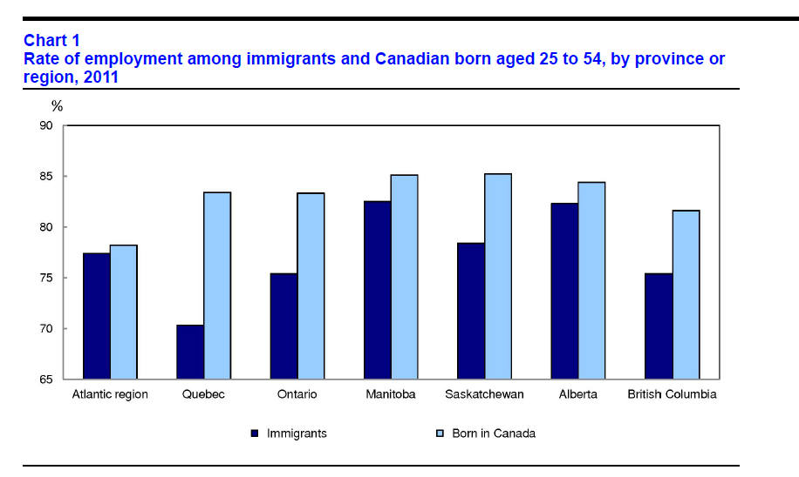
Rate of employment by region, ages 25-54, 2011 (source: Statistics Canada, 2012: 11)

Slide 37
Economic welfare of immigrant cohorts
Richmond and Kalbach, 1980, Factors in the adjustment of Immigrants and their descendants.
For post-war immigrants (arriving 1946-60), given age-sex groups were below the Canadian born in average income at the 1961 census but largely above the Canadian born by the 1971 census
Beaujot and Rappak, 1990, The evolution of immigrant cohorts, in S. Halli, et al., Ethnic Demography.
Last cohort to have done this seems to be the 1975-79 cohort, after 21-25 years in Canada. Others not reaching the Canadian born average after 20 years.
These observations remain true 20 years later.

Slide 38
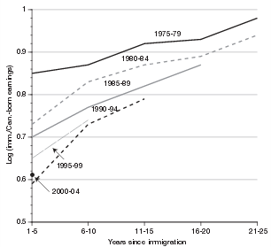
Earnings of immigrants compared to Canadian born, full-time workers, by years since immigration, 1975-2004 (Source: Picot and Sweetman, 2012: 37)

Slide 39
Declining economic welfare of immigrants over successive cohorts (source: Picot and Hou, 2003)
% with low income status
Recent CB CB Lone
immig seniors parents
1980 24.6% 17.2%
2000 35.8% 14.3%
Change +12.2 - 2.9 -12.5 -16.0
Picot and Sweetman, 2005
  Characteristics of immigrants (1/3)
  Decreasing economic returns to foreign work experience
  General decline in labour market outcomes of all new entrants
  Not: reduction in economic return to education

Slide 40
Declining economic welfare of immigrants : other explanations -- Discrimination
Hidden under characteristics?
Lack of recognition of credentials
Jeffrey Reitz, 2001: The capacity of Canadian graduate programs to evaluate many of the degrees from Asian, African, and Latin American universities is actually quite poor. … If universities who specialize in credentials have problems, it is not hard to imagine that employers would also have problems. Universities might be justified in being credential-conservative – tending toward negative decisions in the absence of definite knowledge, in order to protect academic standards. … It is employers who have more to lose from hiring a foreign worker who turns out to be unproductive.
Discrimination affecting more people?
Beaujot et al., 1988, Income of Immigrants in Canada.
Discrimination getting worse?
Yoshida, Yoko and Michael R. Smith, 2008. Measuring and mismeasuring discrimination against visible minority immigrants: The role of work experience. Canadian Studies in Population.

Slide 41
Declining economic welfare of immigrants : other explanations -- Discrimination
Picot and Sweetman (2005: 12): for 1980-2000
Poverty is declining for recent immigrants from US, WE, SE Asia, Caribbean, S&C America.
Poverty is getting worse for recent immigrants from SA, EA, WA, NE, EE, SE, Africa
RED: areas with declining relative share of immigrants
BLUE: areas with increasing relative share of immigrants

Slide 42
Declining economic welfare of immigrants : other explanations – Number of immigrants
Douglas Massey: post-war immigrants had the advantage of following a hyatus.
Now: competing with larger cohorts who arrived earlier.
Since the recession of the early 1980s, not a reduction of immigration during periods of high unemployment.
Laplante, 2011: concern that “the current level of immigration cannot be sustained if the economic integration of immigrants remains an objective”.
Bélanger, 2013: higher numbers present more difficulties of integration.
Bélanger and Bastien, 2013: the main winner is business … keeping labour costs low rather than allowing the competitive market to raise labour compensation.

Slide 43
Declining economic welfare of immigrants : other explanations – Number of immigrants
Bonikowska, Aneta, et al., 2011:
Over the period 1990-2000, entry wages of university-educated immigrants relative to the domestic-born
- Canada: entry wages of immigrants declined
- USA: wages of new immigrants increased
Higher level of immigration in Canada: Over 1990-2005, net immigration relative to the 1990 population:
- Canada: 8.9%
- US: 7.6%
Percent of new adult immigrants who have university degrees:
Canada USA
1990 25% 30%
2000 47% 34%

Slide 44
Discussion
Economic well being of immigrant cohorts:
- Advantages of the post-war immigrants: following a hiatus
- Subsequent cohorts: composition, receiving economy, demographics of baby boom, size of cohorts
Political economy:
Interests of capital and labour
Grubel (2005): open immigration is contradictory to a welfare state
- Massey et al. (1994): various institutions and agents come to have a vested interest
Immigration and economics
Size of population, labour force and economy (large effect)
Per capita income and public expenditure (very little effect)

Slide 45
Discussion: Labour shortage
Kevin McQuillan, 2013, All the workers we need: Debunking Canada’s labour-shortage fallacy
  No evidence that any increase in immigration is necessary
  Better equip Canadian workers with the education, training and skills that employers are looking for, and mobilize unemployed workers … to provinces with a greater need for workers.
Don Drummond, Is Canada’s great skill shortage a mirage?
  6.3 unemployed people for every job vacancy
  No wage spikes in skilled trades
  Canada Job Grant is built on a false assumption
Temporary Foreign Workers, concerns expressed in media
  Taking jobs from Canadians
  Downward pressure on wages
  Serving the interests of employers rather than labour
  Undermining other adjustments in the labour market based on wages, training and internal migration

Slide 46
Discussion: Policy
What should be the level of immigration?
What should be the composition of immigration:
  By class: economic, family, refugee
  By socio-economic
  By socio-cultural
How to maximize integration
How to maximize benefits to Canada
How to maximize benefits to sending countries
How to maximize benefits to immigrants themselves

Slide 47
Discussion
All told, policy needs to balance a number of considerations,
ranging from the functioning of a multi-cultural and pluralist society,
including playing humanitarian roles toward the persecuted and dispossessed,
to questions of discrimination and the economic integration of immigrants,
and the functioning of a knowledge economy in a more open globalizing world.

Slide 48
Thank you
Available at: rbeaujot@uwo.ca
mraza7@uwo.ca

Slide 49
Demographics: role of immigration in population growth
1 July 2010 – 1 July 2011
Births 383,600
Deaths 244,700
Natural increase 138,900
Immigration 270,600
Net change in non-permanent 34,200
Emigration 47,200
Net international migration 257,600
Total growth 396,500
Percent of growth due to migration: 65%
More immigrants than births?

